Slide 1

Tinkering Boot Camp
Week 3 | Session 1

Slide 2
Libraries to be included
Wifi
Wifi101
Blynk
ESP32 AnalogWrite
ESP32httpUpdate
ESP32WifiManager
ESPSoftwareSerial

Slide 3
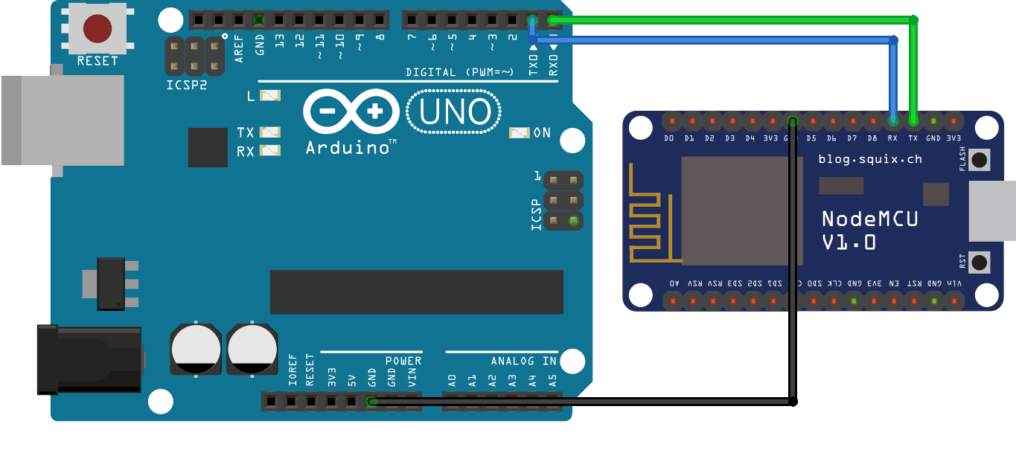
SoftwareSerial.h

Slide 4


Slide 5

SoftwareSerial.h

Slide 6
Functions in Arduino IDE
BLYNK_WRITE()
BLYNK_READ()
Timer
These are some basic ones, there are many more widgets and functions to look into like-
Bridge
Joystick and so on
You can try this by yourself for fun

Slide 8
Integrating with Voice Assistant
Why Voice Assistant?
It makes your childhood dream come true, you just speak to turn off the light and this system do it for you.
IFTTT is the solution
It is just a if condition, but takes command from one place in the internet and gives to another

Slide 9
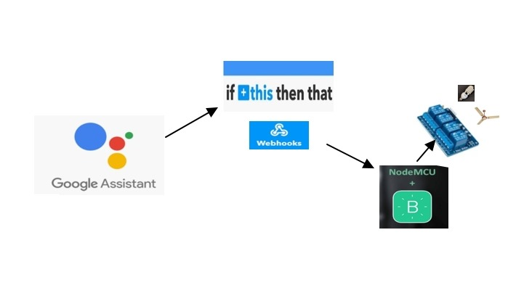

Slide 11
Other References-
Codes we used-
Serial Communication
Virtual Pins
Show data on Blynk app
Integrating with Voice Assistant
Example Code for all the widgets and functions

